Slide 1
Mobile app innovation
Notes:
Information in this document, including URL and other Internet Web site references, is subject to change without notice. Unless otherwise noted, the example companies, organizations, products, domain names, e-mail addresses, logos, people, places, and events depicted herein are fictitious, and no association with any real company, organization, product, domain name, e-mail address, logo, person, place or event is intended or should be inferred. Complying with all applicable copyright laws is the responsibility of the user. Without limiting the rights under copyright, no part of this document may be reproduced, stored in or introduced into a retrieval system, or transmitted in any form or by any means (electronic, mechanical, photocopying, recording, or otherwise), or for any purpose, without the express written permission of Microsoft Corporation.
Microsoft may have patents, patent applications, trademarks, copyrights, or other intellectual property rights covering subject matter in this document. Except as expressly provided in any written license agreement from Microsoft, the furnishing of this document does not give you any license to these patents, trademarks, copyrights, or other intellectual property.
The names of manufacturers, products, or URLs are provided for informational purposes only and Microsoft makes no representations and warranties, either expressed, implied, or statutory, regarding these manufacturers or the use of the products with any Microsoft technologies. The inclusion of a manufacturer or product does not imply endorsement of Microsoft of the manufacturer or product. Links may be provided to third party sites. Such sites are not under the control of Microsoft and Microsoft is not responsible for the contents of any linked site or any link contained in a linked site, or any changes or updates to such sites. Microsoft is not responsible for webcasting or any other form of transmission received from any linked site. Microsoft is providing these links to you only as a convenience, and the inclusion of any link does not imply endorsement of Microsoft of the site or the products contained therein.
© 2018 Microsoft Corporation. All rights reserved. Microsoft and the trademarks listed at https://www.microsoft.com/en-us/legal/intellectualproperty/Trademarks/Usage/General.aspx are trademarks of the Microsoft group of companies. All other trademarks are property of their respective owners.

Slide 2
Abstract and learning objectives
Abstract
In this whiteboard design session, you will work with a group to design an IoT solution using data emitted from RFID tags attached to airline passengers' checked luggage, and mobile applications to allow employees and customers to track those bags from any device.
At the end of this whiteboard design session, you will be better able to design an IoT solution, including mobile apps, by leveraging cloud services.
Notes:
This is an introduction to the Cloud Workshop at a high level. Later we’ll get into customer objections, requirements, etc… but we want to ground the participants on the business outcomes we’re going after for the day.

Slide 3
Step 1: Review the customer case study
Outcome
Analyze your customer needs
Timeframe
15 minutes

Slide 4

Customer situation
Contoso Air is a leader in the air travel industry
Customer is modernizing applications and infrastructure to remain competitive
Customer wants a PoC baggage handling and tracking process using RFID tags
Their cloud systems must be capable of securely retrieving data from on-premises systems
Notes:
Founded in 1932, Contoso Air is a leader in the air travel industry, servicing more than 70 countries/regions around the world. As a large, globally distributed company, with tens of thousands of employees, Contoso Air has been slow to adopt and integrate modern technologies into their business processes and operations, causing them to lose ground to small, more nimble competitors. This has also lead to some dissatisfaction among customers and employees, who are increasingly mobile and technologically savvy.
They recently launched an initiative to modernize their applications and infrastructure, starting with migrating their email, file sharing, collaboration, chat and VoIP systems into the cloud, leveraging services provided by Office 365. For this, they also set up federated Active Directory, and have resources spread across three Azure regions. Ultimately, they hope to move to a 100% cloud infrastructure eventually, but they have numerous legacy systems which will be extremely costly to upgrade and migrate.
Sage Robertson, Contoso Air’s CTO, has requested a proof-of-concept (PoC) solution for leveraging Azure to modernize their baggage handling and tracking process. This solution should include the introduction of RFID luggage tags, equipping baggage handlers with mobile scanning devices, and a customer luggage tracking mobile application. Mobile applications should allow customers and employees to accurately track the location of a piece of luggage, from the time the customer checks it to them retrieving it from baggage claim. This solution must be able to securely bridge to their on-premise infrastructure to retrieve customer flight and ticketing data.

Slide 5

Customer needs
Low-latency global data replication
Apps for web, iOS, Android, and UWP
Real-time location data for baggage
RFID labels, antennas, scanners, and employee mobile application
Ability to rapidly build, test, and deploy application updates
Notes:
Low-latency data replication across geographical regions
Client applications for web, iOS, Android, and UWP
Real-time location data for baggage
RFID labels, antennas, scanners, and employee mobile application
The ability to quickly innovate on new mobile application features with high quality
Automated Build, Test, and Deployment
Crash/Analytics
Dashboarding

Slide 6

Customer objections
Worried about potential security-related disruptions
Can Azure reliably communicate with IoT RFID scanners?
Is Xamarin the right tool for mobile app development?
Notes:
Contoso Air is worried about potential security-related disruptions to the system.
There is concern over Azure’s ability to communicate reliably with IoT RFID scanners.
Is Xamarin the right solution for the customer mobile applications?

Slide 7

Customer objections
How can low data latency be assured?
Will the solution scale meet our needs?
How will on-premises data be securely queried by the cloud solution?
Notes:
How does this solution guarantee low data latency?
There will be thousands of scanners being used at a given time, does this solution scale?
The new system may require querying data from on-premises data sources, how do you bridge that gap?

Slide 8
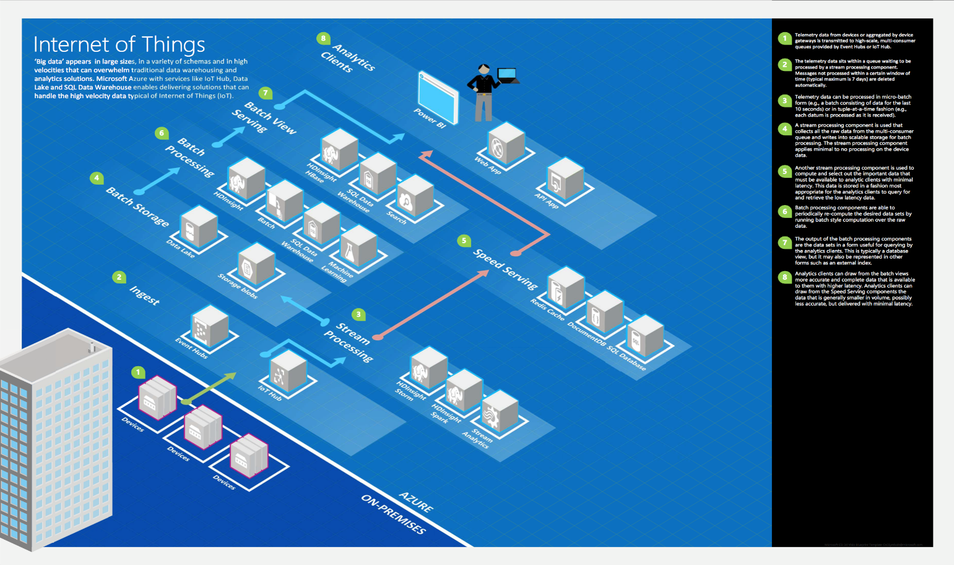
Common scenarios
Notes:
This is a diagram of a common architecture for this type of scenario, from which you can draw inspiration. You will find this diagram within the Whiteboard Design Session Student Guide.

Slide 9
Step 2: Design the solution
Outcome
Design a solution and prepare to present the solution to the target customer audience in a 15-minute chalk-talk format.
Timeframe
60 minutes
Business needs (10 minutes) | Respond to questions outlined in your guide and list the answers on a flipchart.
Design (35 minutes) | Design a solution for as many of the stated requirements as time allows. Show the solution on a flipchart.
Prepare (15 minutes) | Identify any customer needs that are not addressed with the proposed solution. Identify the benefits of your solution. Determine how you will respond to the customer’s objections. Prepare for a 15-minute presentation to the customer.

Slide 10
Step 3: Present the solution
Outcome
Present a solution to the target customer in a 15-minute chalk-talk format
Timeframe
30 minutes (15 minutes for each team to present and receive feedback)
Directions
Pair with another table
One table is the Microsoft team and the other table is the customer
The Microsoft team presents their proposed solution to the customer
The customer asks one of the objections from the list of objections in the case study
The Microsoft team responds to the objection
The customer team gives feedback to the Microsoft team

Slide 11
Wrap-up
Outcome
Identify the preferred solution for the case study
Identify solutions designed by other teams
Timeframe
15 minutes

Slide 12

Preferred target audience
Sage Robertson, CTO, Contoso Air
Primary audience is business and technology decision makers
Usually talk to Infrastructure Managers who report to the CIO, or to application sponsors (like a VP LOB, CMO) or to those that represent the Business Unit IT or developers that report to application sponsors
Notes:
Sage Robertson, CTO, Contoso Air
The primary audience is business decision makers and technology decision makers.
Usually we talk to the Infrastructure Managers who report to the CIO, or to application sponsors (like a VP LOB, CMO) or to those that represent the Business Unit IT or developers that report to application sponsors.

Slide 13
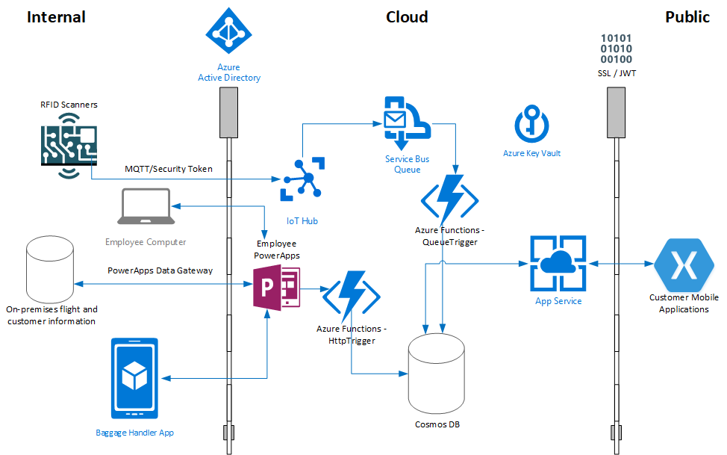
Preferred solution
Notes:
This preferred solution is just one of many viable options
From a high-level:
Contoso Air employees affix RFID tag to customer’s checked luggage, and associates it with the customer and flight information using a PowerApps application.
The PowerApps application triggers this information to be stored in Cosmos DB via an HttpTrigger.
RFID scanners along luggage conveyor belts scan the tags.
The RFID scanner utilizes MQTT protocol to send a status message for the luggage to an IoT Hub.
The IoT Hub is configured with a Service Bus Queue endpoint and corresponding filter that identifies the status message.
Messages are matched and forwarded to the Service Bus Queue. Having the messages sent to the Service Bus Queue ensures reliability as items will not be removed from the queue until processed.
Azure Function triggered by queue stores the current location of the luggage into Cosmos DB.
Luggage is again scanned using a PowerApps mobile application as it is loaded onto the plane.
An Azure function is initiated via an HttpTrigger when the luggage is scanned, and the location of the luggage is updated as having been loaded on the plane.
Once all luggage has been loaded onto the plane, the baggage handler application sends another message indicating all bags are loaded on the plane, this status is also sent along to Cosmos DB via an HttpTrigger.
PowerApps push notifications and email notifications sent to personnel for any discrepancies.
Customers can access their Xamarin-based mobile application to view luggage location details.
Using the same workflow as outlined above, once the flight has landed at its destination, each bag is scanned upon its removal from the plane and its location information is updated. The luggage is then placed on the luggage conveyor belt at baggage claim where RFID scanners will again scan them and update their location. The customer is then able to retrieve their bag from baggage claim.

Slide 14
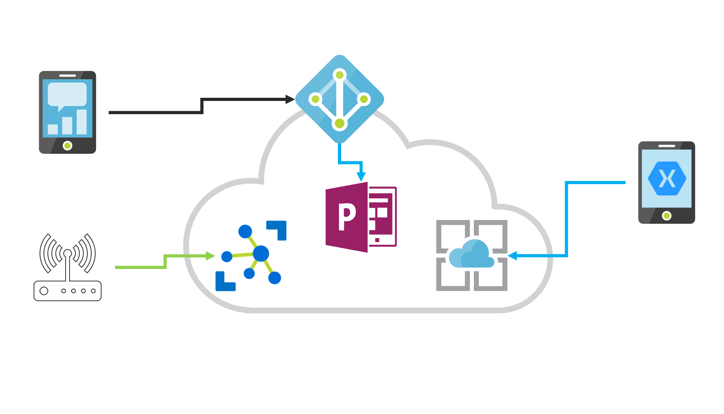
Preferred solution
Data Security
Notes:
Given their existing services, how would you ensure that all communication to and from the system is secured? How would you authenticate and authorize an RFID scanner client?
With the use of the Azure IoT SDK, authentication and authorization of a device can occur using the MQTT protocol automatically using only the IoT Hub connection string. Alternatively, MQTT can be used directly (in cases where the SDK can’t be used) by issuing a CONNECT packet that provides a Client Id, Username and Password – where password is a generated SAS token. It is important to note that MQTT tokens are time sensitive and have an expiration.
How would you authenticate and authorize an employee using a client application?
Given Contoso Air is already federating their AD, it makes sense that any employee-related client applications utilize Azure Active Directory.
How would you authenticate and authorize a customer using a mobile application?
Using the authentication extension of the backend server SDK for Azure Mobile App, federated authentication via Azure Active Directory, Facebook, Google, Microsoft or Twitter is possible. If their current external facing website uses a different identity provider, the SDK also allows for custom identity provider integration through custom code. Furthermore, API controllers and/or methods can be additionally secured individually, for instance, for a .NET backend, using the [Authorize] attribute.
How would you ensure that in-transit data is secured?
Communications into Azure IoT Hub can use TLS/SSL configuration, similarly when connecting the Xamarin applications to the Azure App Service, SSL may be used. Communications from employee applications are secured using Azure Active Directory with the credentials of the actual user.

Slide 15
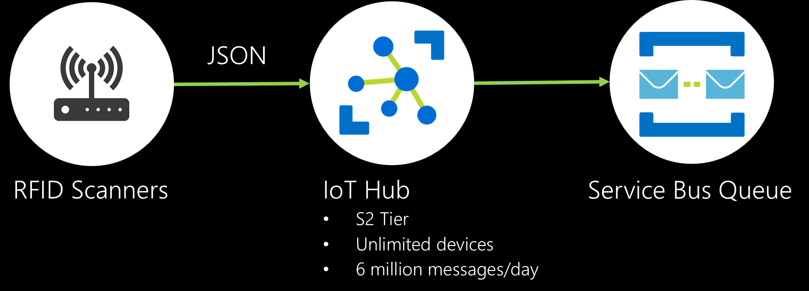
Preferred solution
Data Ingestion
Notes:
What format would you choose for the messages being ingested by the system?
JSON format as it is currently the most popular format for modern IoT and Web Systems.
Define the messages that need to be ingested.
JSON messages will be similar to the following:
{
“baggageId” : “double”,
“customerId”: “double”,
“scannerId”: “int”,
“flightId”: “int”,
“locationId”: “value”,
“timestamp”: “timestamp”,
“status”: “string”,
“isBaggageMessage”: bool
}
The status value will be determined by the source of the message. For example, a message sent from an employee checking in a bag for a customer would be assigned a status of “desk-check-in”, and an RFID scanner would have a status of “rfid-scanner,” allowing each message to be associated with the mechanism sending it. The isBaggageMessage property indicates whether the message was received as a result of scanning the RFID tag on a piece of luggage, or if the message was sent by an employee using a mobile app, such as a baggage handler sending a message that the last bag has been loaded onto a flight.
What is the anticipated volume in messages expected from the RFID IoT solution that Contoso Air will need to support given their employee and customer base?
Contoso Air has distributed their Azure resources across 3 regions. At any given time, Contoso has an average of 120 active flights on the ground (processing baggage) at 60 locations worldwide. Each flight has an estimated 180 customers with an average of 360 checked bags. Each bag’s location is recorded at minimum 5 times for each flight, 2 of which occur via RFID scanners. Assuming that it takes one hour to get bags from one location at an airport to another, at maximum, they can expect 120 (flights) x 360 (bags) x 2 (rfid checkpoints) messages per hour divided across their 3 Azure regions. (120 x 360 x 2)/3 = 28,800 messages per hour per region or 691,200 messages per day per region. As such, implementing an IoT hub in each region at the S2 level (unlimited devices, 6 million messages per day is required and provides much room for future growth). At the service bus level, approximately 22 million messages will be processed per month per region. This means the basic tier will suffice at $0.05/million messages ($1.10 per region per month).
How would you propose they ingest that quantity of RFID messages? What Azure service(s) would you recommend and why? At what initial scale?
As the daily messages exceed 400k per region, implementing an IoT hub in each region at the S2 level (unlimited devices, 6 million messages per day) is required and provides plenty of room for future growth. At the service bus level (queue), approximately 22 million messages will be processed per month per region. This means the basic tier will suffice at $0.05/million messages ($1.10 per region per month).
What protocol would they use in sending data to the service(s) used for message ingestion?
Currently the most popular protocol for IoT devices to send data to IoT Hub is via MQTT.
Define any endpoint(s) used for message ingestion.
<tbd>. .azure-devices.net

Slide 16
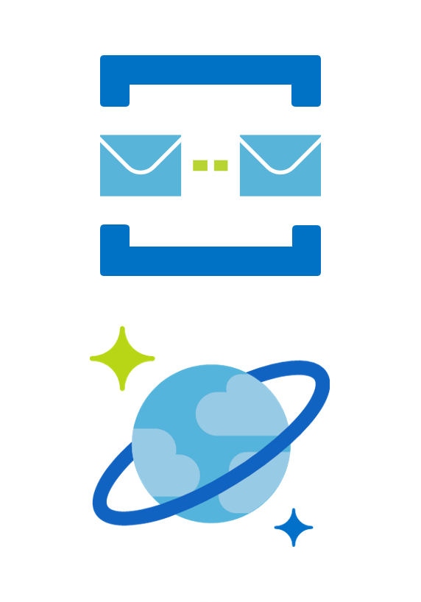
Preferred solution
Data Processing
Service Bus Queue will house messages until processed
Use Cosmos DB to persist data
Cosmos DB geo-replication
Notes:
What Azure service would you use to guarantee ingested data is processed reliably?
Azure IoT Hub is designed to ingest data at a high scale. To ensure ingested data is processed reliably, a filter is defined to identify the incoming baggage messages that will forward them to a Service Bus Queue. This queue will house all messages until such a time that they are processed. This means that even during peak loads, no messages will be lost, and all messages will eventually be processed from this queue.
How would you ensure that the data is processed with low-latency?
IoT Hubs and Service Bus Queues are put in place in each of the 3 Azure regions chosen by Contoso Air. This means that data is processed closest to the source geographically thus reducing latency.
Which Azure service would you use to persist the current state of the RFID luggage tag?
Cosmos DB is chosen to persist the data and history of the RFID luggage tag.
How will you ensure that persisted data is available at low-latency around the globe?
Cosmos DB is automatically geographically replicated across all regions around the world. This ensures data is available globally at low-latency.

Slide 17
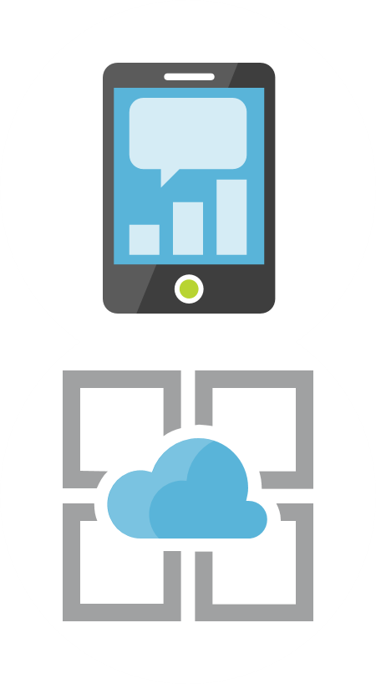
Preferred solution
Data Exposure
Azure Mobile Application Services
Extend Azure App Services
HTTPS communication
Notes:
What Azure service would you recommend that will provide read-only luggage information to the Customer mobile application. Why did you make this choice?
Azure Mobile Application Services will be used to service the Customer mobile application. These services extend Azure App Services by adding support for things like user sign-in and push notifications.
What protocol is used when the Customer mobile application initiates communication with the service you decided upon in #1?
HTTPS will be used to ensure secure communication between the mobile application and the mobile App Services.

Slide 18
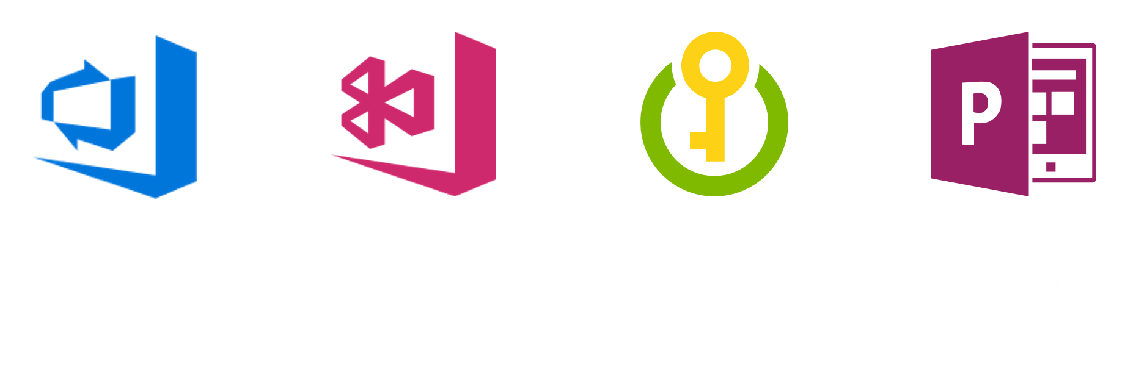
Preferred solution
Client Applications
Notes:
Which Azure service do you recommend using for housing application source code?
Azure DevOps
What Azure services do you recommend for automated builds, testing, and deployment?
Azure DevOps and Visual Studio App Center (VSAC) for the Xamarin Application. VSAC provides a centralized conglomeration of services focusing on critical mobile development activities. These services include source control, automated builds/continuous integration, testing, distribution, persistent data storage, authentication (including AAD), crash reporting, and analytics.
Which Azure service would you use to store application secrets, such as certificates or connection strings so that they aren’t readily available in client application source control?
Azure Key Vault
How would you bridge data between on-premises systems and Microsoft Azure?
The only area where on-premises data is required is through the employee applications that are implemented using PowerApps. PowerApps Data Gateway is a tool that provides a way to define hybrid connections between on-premises data sources and the employee PowerApps. Similarly, if the need arises, the Azure Service Bus can be used to create hybrid connections to on-premises data.
What Azure service would you recommend for Contoso Air business users to be able to self-service a CRUD (Create, Read, Update, Delete) application that can be made available on both web and mobile?
PowerApps provide a way for employees of Contoso Air to tailor their own applications to suit the needs of their everyday work.

Slide 19
Preferred objections handling
Worried about potential security-related disruptions
Can Azure reliably communicate with IoT RFID scanners
Is Xamarin the right tool for mobile app development
Notes:
Contoso Air is worried about potential security-related disruptions to the system.
Throughout the design of this solution, security has been at the forefront of the decisions.
All communication between environments, devices and regions are performed over secured channels.
TLS/SSL from RFID channels, Active Directory and client credentials from employee applications, as well as SSL and a JWT-token based security in the Xamarin-based mobile application.
There is concern over Azure’s ability to communicate reliably with IoT RFID scanners.
There are 3 Azure regions already defined for Contoso Air. The IoT hub and Service Bus Queues are implemented in all regions to ensure the best quality communication.
Is Xamarin the right solution for the customer mobile applications?
Xamarin Forms has been chosen as the solution for the mobile applications. This makes sense as the definition of the user interface is ubiquitous across all the target mobile platforms for this application, thus reducing development time.

Slide 20
Preferred objections handling
How can low data latency be assured
Will the solution scale to meet our needs
How will on-premises data be securely queried by the cloud solution
Notes:
How does this solution guarantee low data latency?
All Azure resources in this solution are either implemented or replicated into all main regions identified by Contoso Air.
There will be multiple of scanners being used at a given time, does this solution scale?
From an IoT perspective, the IoT hub has been designed to be able to ingest an immense amount of data. Given that the Contoso Air recommended tier for the IoT Hub (S2) allows for 6 million messages a day, they will only be expecting approximately 700K messages, allowing lots of space for future growth.
The new system may require querying data from on-premises data sources, how do you bridge that gap?
On-premises data can be bridged with PowerApps Data Gateway or a Hybrid connection endpoint defined in the Azure Service bus.

Slide 21
Customer quote
“Contoso Air is excited to be expanding its cloud capabilities with this solution. Azure has already proven itself from our previous projects and efforts. We are confident that this solution will allow us to improve our baggage metrics immensely while at the same time improving our customer satisfaction numbers.”
- Sage Robertson, CTO, Contoso Air

